Slide 1
Office Pet
The next generation digital pet, powered by AI
Built by: Ben Franzi, Dylan Fu, Daniel Waldow and Iza Wojciak
Notes:
Hi everyone,

Slide 2
Live Demo
Notes:
Run a basic demo in the Alexa cloud console showcasing the following:
Adopt pet
Describe {PET_NAME}
Feed pet
Give {PET_NAME} a treat
Clean pet
Wash pet
How is {PET_NAME} doing?

Slide 3






Why build this in the first place?
Notes:
While on the bench, we were studying for AWS certification. For anyone that has followed this path you will know how mind-numbing the course is, and how little practical application the course offers for building a cloud native app.
In order to practice actually building a project leveraging AWS cloud products, we brainstormed some ideas for an app we could build. Nothing small enough in scope was immediately obvious.
Later that week during a lecture on AWS Lambda triggers, I discovered you can trigger serverless functions with an Alexa device. It became clear at that moment the world needed a modern day tamagotchi-like app you could interact with on your Alexa device.
Enter: Office Pet

Slide 4

High-level Architecture Diagram
Notes:
Architecture
From left to right, we start with an Alexa enabled device, like the one we have here in the office
A user will talk to the Alexa device, which will send input data to the AWS Alexa service, which will launch an Alexa Skill, which is what AWS calls an app
Once our Alexa Skill is launched it will communicate with our application code, which is hosted in a serverless lambda function
In order to persist data between sessions in our Skill, our code will trigger reads and writes to a DynamoDB
Sessions:
Alexa session starts on launch then communicates with the application code in our lambda function
The lambda function will trigger a launch function which fetches any related pet data from DynamoDB
Whenever a new voice interaction is triggered, the alexa session will fire a new Lambda invocation
When the alexa session is closed, it will trigger a function to persist all locally stored pet data to DynamoDB

Slide 5


Alexa Skill Lifecycle
Launch
Launch Handler
Help
Help Handler
Hello Intent
Hello Intent Handler
…
… Handler
Notes:
Here we dive a little deeper into the lifecycle of an Alexa Skill interaction.
On the bottom left we can see the user input captured by the device and sent to the Alexa service.
The Alexa service has all of the natural language processing and machine learning working away under the hood which converts an audio file to a string of text.
This string is then matched against one of the sample phrases we have provided and maps to what is known as an ‘Intent’. An intent represents a particular action the user wants to perform during an interaction. In this example, we will assume the user wants to perform the ‘Hello’ intent.
Once we have successfully matched the users’ phrase to an intent, it is sent to our lambda function.
Our code has a registered list of intents that the Alexa SDK tries to match from top to bottom with the intent sent from the Alexa service
Once we match the intent in the lambda function it will invoke the matching handler that will run code for this particular part of our application, in this case the ‘Hello Intent Handler’
Alexa Skill Lifecycle - Code Walkthrough
Voice -> Alexa parse into text -> Match intent -> Skill code hosted in Lambda -> Return response back to Alexa.
In the lambda, it will map the intent to the relevant handler and execute the code in the handler.

Slide 6
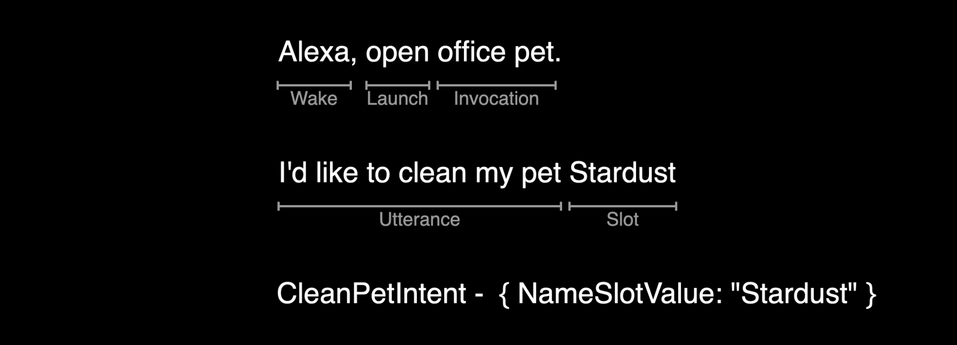
Designing an Alexa Skill
VUI
Voice User Interface
Notes:
Designing the Alexa Skill
How does Alexa actually match our user utterance with an intent?
We need to consider the Voice User Interface and how the user will interact with our Alexa skill/app
We need to think about what we want the app to do (intents):
Clean
Feed
Greet
What user phrases (utterances) will trigger these intents
Few key - Voice concepts when building our VUI:
Which are used to launch alexa and open our alexa skill/app
Wake
Launch
Invocation Name
Utterance with optional Slots
Intents
Go through example
This is all represented as the interaction model in a json file. This file is used by the Alexa service along with its NLP and ML to match the intents.

Slide 7




The app is finished… now what?
Notes:
Initially it was quite quick to put the app together. We had the basic functionality built in that you would expect from a Tamagotchi clone. Time to add our extended scope right?
One of the biggest problems with Office Pet was that other than cleaning, feeding and asking how your pet is doing, Alexa would not be able to process any request that wasn’t one of the 4 pre-defined intents we had written. This meant you would spend more time hearing about what you couldn’t do with your pet than actually interacting with it.
Upon hearing this, Gui jokingly suggested we should hook up office pet to ChatGPT so we could make Office Pet smarter.
So that is exactly what we did…

Slide 8

OpenAI to the rescue
Intents
Handlers
Launch
…
Help
…
Adopt Pet
…
Feed Pet
…
Clean Pet
…
Describe Pet
…
Pet Status
…
Catch All
OpenAI
Cancel / Stop
…
Ended
…
Notes:
Whereby we added a new OpenAI Handler which is triggered by the catch all intent.
This new handler will talk with the OpenAI API to help us curate a response.
To improve the response we also provide context our the pets’ attributes to produce a response with congruent with our pets attributes,
such as if he pet is a cheerful or more reserved pet

Slide 9
Live Demo
OpenAI Curated Response
Notes:
Options:
Let’s bake a cake together
Can you help me with my tax return?
Let’s go on an adventure

Slide 10
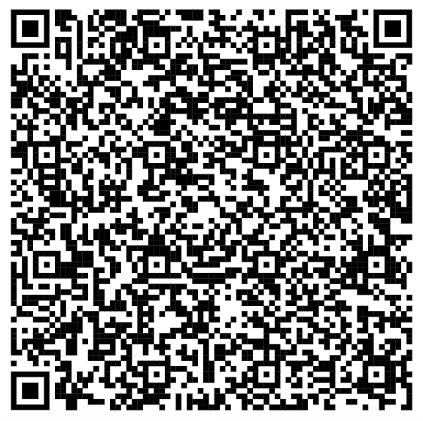
Download Free Today!
Alexa Skill Store

Slide 11
Q & A
Check out the repo at github.com/Lexicon-Digital/office-pet

